Slide 1
Math 769: Statistical Learning

Slide 2
Statistical Tools
Shahrzad Jamshidi, PhD

Slide 3
Last Time
Assumptions of linear regression:
Linearity
Independence
Little or No Multicollinearity
Homoscedasticity
Normality

Slide 4
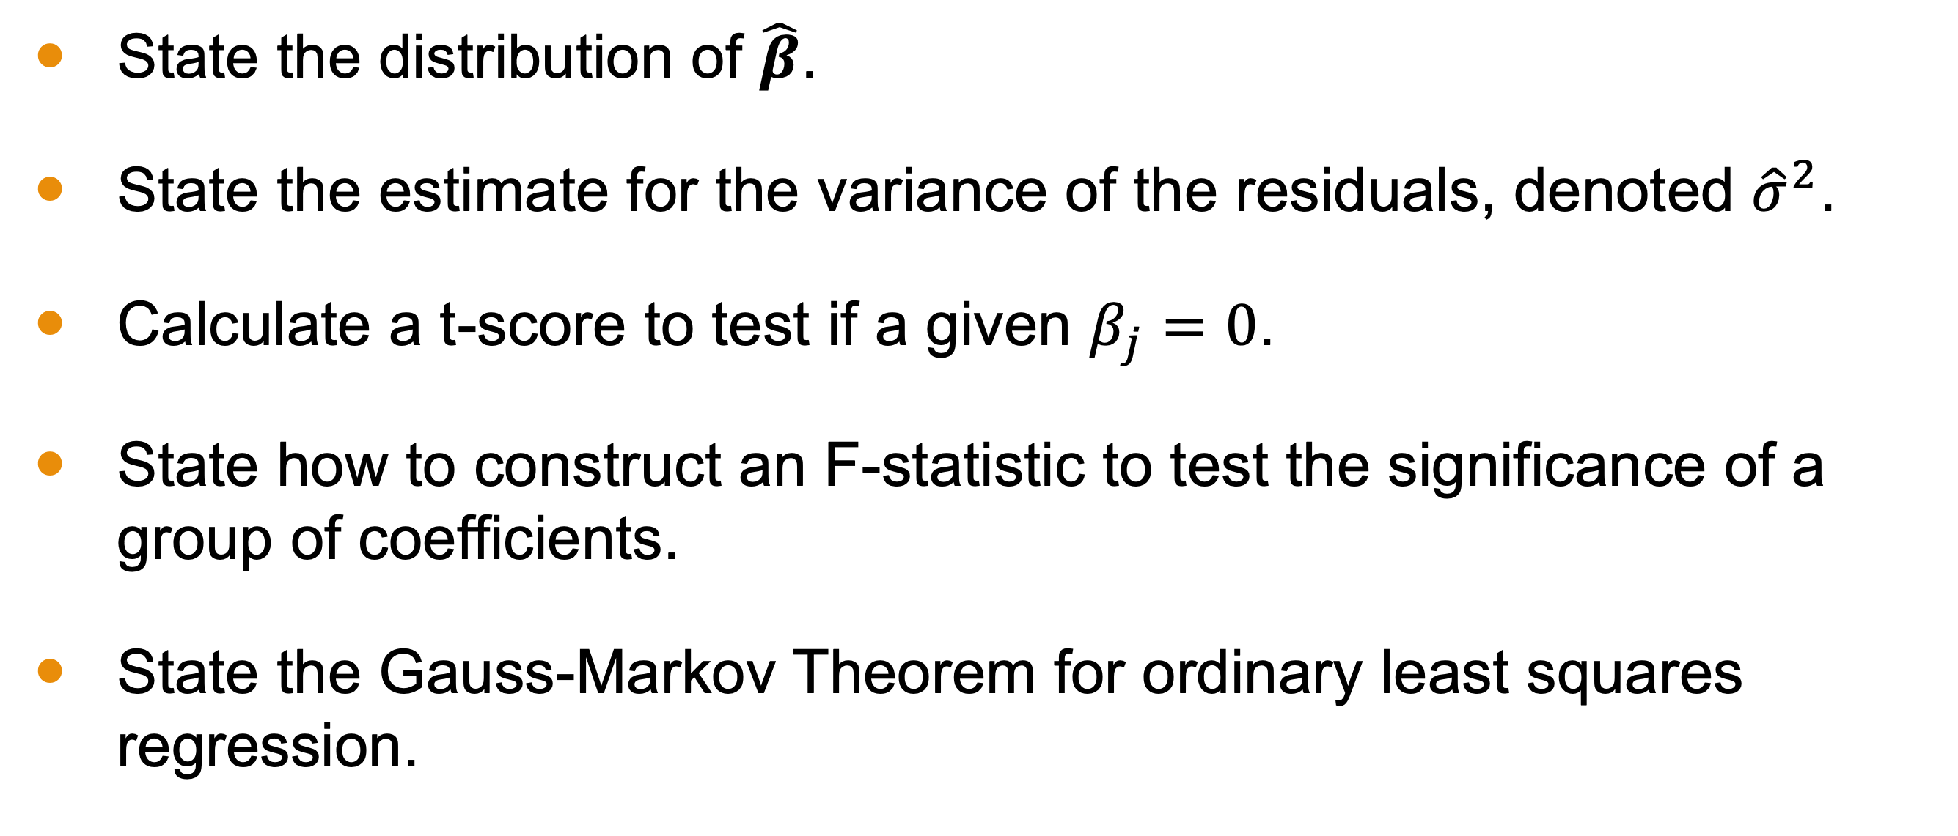
Objectives for this Lesson
State the distribution of $\hat{β}$.
State the estimate for the variance of the residuals, denoted ${\hat{σ}}^{2}$.
Calculate a t-score to test if a given $β_{j}=0$.
State how to construct an F-statistic to test the significance of a group of coefficients.
State the Gauss-Markov Theorem for ordinary least squares regression.

Slide 5
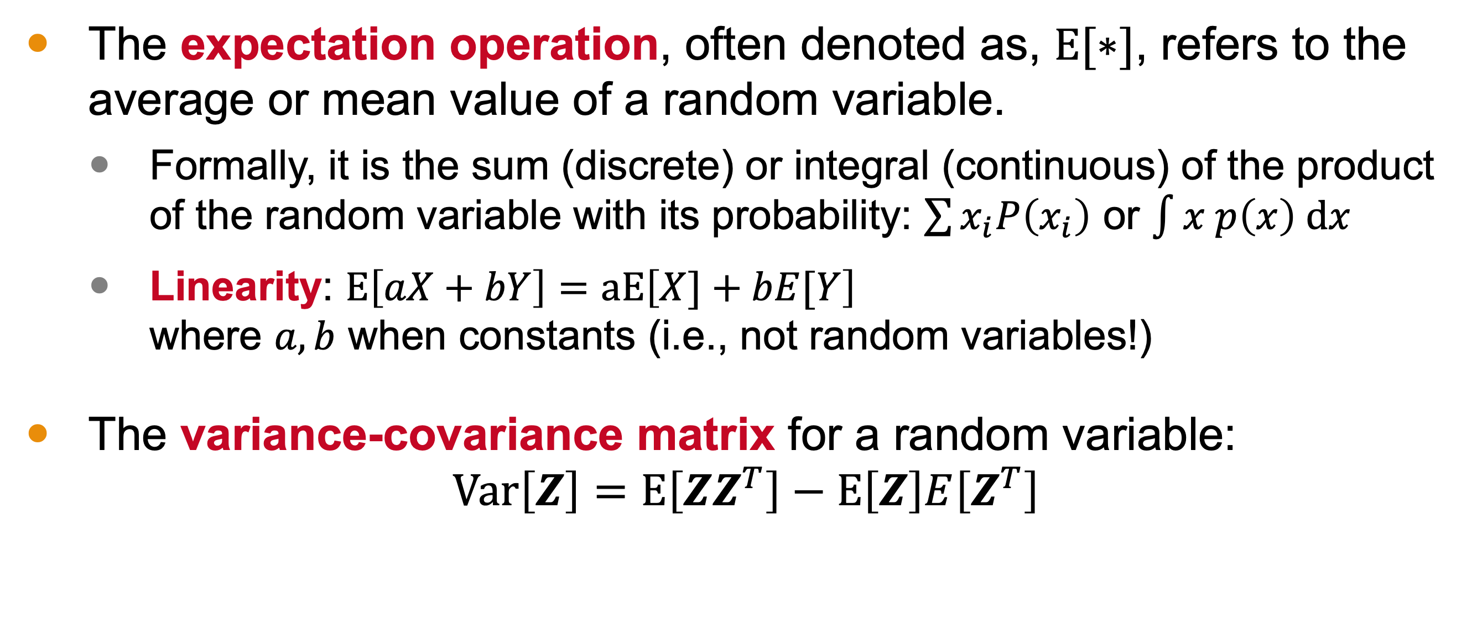
Recall from Prerequisite
The expectation operation, often denoted as, $E[∗]$, refers to the average or mean value of a random variable.
Formally, it is the sum (discrete) or integral (continuous) of the product of the random variable with its probability: $\sum{x_{i}P\left(x_{i}\right)}$ or $\int{x p\left(x\right) dx}$
Linearity: $E\left[aX+bY\right]=aE\left[X]+bE[Y\right]$ where $a, b$ when constants (i.e., not random variables!)
The variance-covariance matrix for a random variable: $\text{Var}\left[Z\right]=E\left[{ZZ}^{T}\right]−E\left[Z\right]E\left[Z^{T}\right]$
Notes:
Do I add independence? E[XY] = E[X]E[Y]

Slide 6

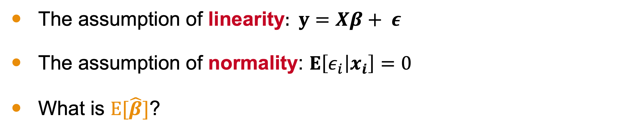


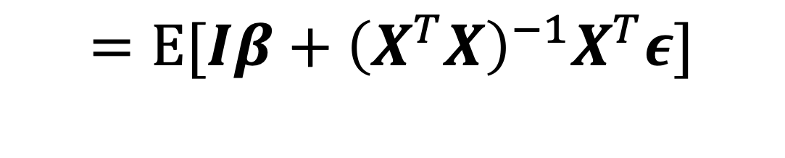


Expectation of $\hat{β}$
The assumption of linearity: $y=Xβ+ ε$
The assumption of normality: $E\left[ε_{i} | x_{i}\right]=0$
What is $E[\hat{β}]$?
$$E\left[\hat{β}\right]=E[{\left(X^{T}X\right)}^{−1}X^{T}y]$$
$$=E[{\left(X^{T}X\right)}^{−1}X^{T}(Xβ+ ε)]$$
$$=E[Iβ+{\left(X^{T}X\right)}^{−1}X^{T}ε]$$
$$=E\left[β\right]+E[{\left(X^{T}X\right)}^{−1}X^{T}ε]$$
$$=β$$

Slide 7
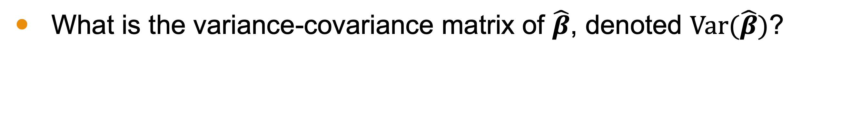

Variance of $\hat{β}$
What is the variance-covariance matrix of $\hat{β}$, denoted $\text{Var}(\hat{β})$?
$$Var(\hat{β})=E\left[{\hat{β}\hat{β}}^{T}\right]−E\left[\hat{β}\right]E\left[{\hat{β}}^{T}\right]$$

Slide 8

$Var(\hat{β})$ can be written in terms of the variance of the residuals, $σ^{2}$!

Slide 9
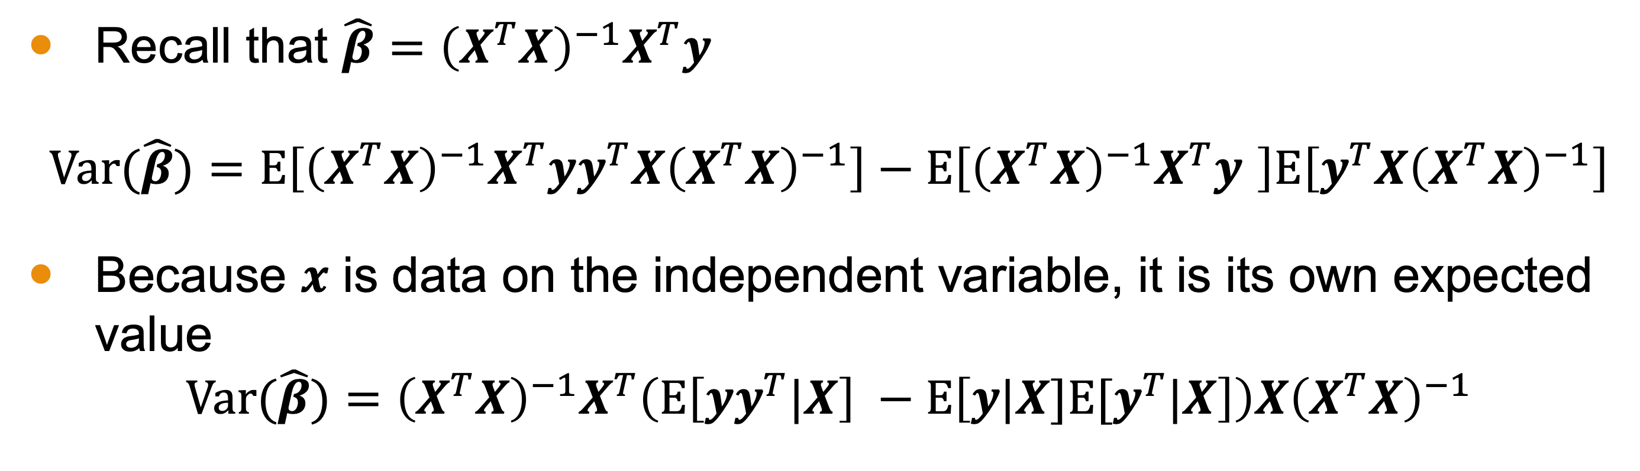


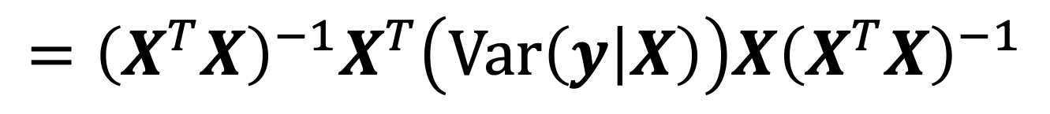
Variance of $\hat{β}$ Continued
Recall that $\hat{β}={\left(X^{T}X\right)}^{−1}X^{T}y$
$$Var(\hat{β})=E\left[{\left(X^{T}X\right)}^{−1}X^{T}yy^{T}X{\left(X^{T}X\right)}^{−1}\right]−E\left[{\left(X^{T}X\right)}^{−1}X^{T}y \right]E\left[y^{T}X{\left(X^{T}X\right)}^{−1}\right]$$
Because $x$ is data on the independent variable, it is its own expected value
$$Var(\hat{β})={\left(X^{T}X\right)}^{−1}X^{T}\left(E\left[yy^{T}|X\right] −E\left[y{|X]E[y}^{T}|X\right]\right)X{\left(X^{T}X\right)}^{−1}$$
$$={\left(X^{T}X\right)}^{−1}X^{T}\left(Var\left(y | X\right)\right)X{\left(X^{T}X\right)}^{−1}$$
$$={σ^{2}\left(X^{T}X\right)}^{−1}$$
(by Homoscedasticity)

Slide 10
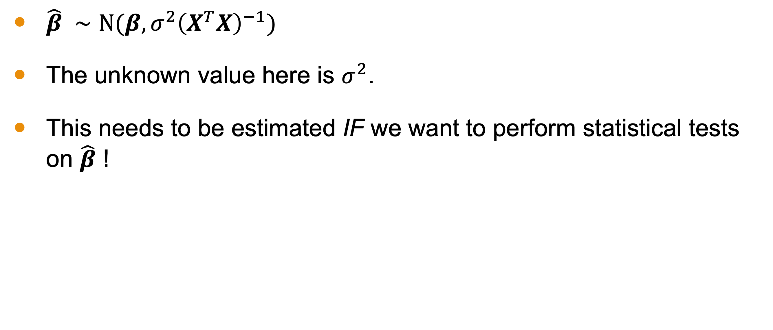

Behavior of $\hat{β}$
$\hat{β} ∼N(β,{σ^{2}\left(X^{T}X\right)}^{−1})$
The unknown value here is $σ^{2}$.
This needs to be estimated IF we want to perform statistical tests on $\hat{β}$ !

Slide 11
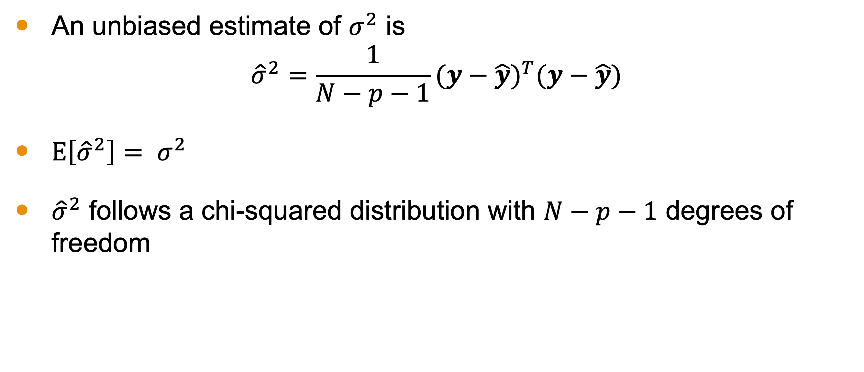

Estimating $σ^{2}$
An unbiased estimate of $σ^{2}$ is
$${\hat{σ}}^{2}=\frac{1}{N−p−1}{(y−\hat{y})}^{T}(y−\hat{y})$$
$E\left[{\hat{σ}}^{2}\right]= σ^{2}$
${\hat{σ}}^{2}$ follows a chi-squared distribution with $N−p−1$ degrees of freedom

Slide 12

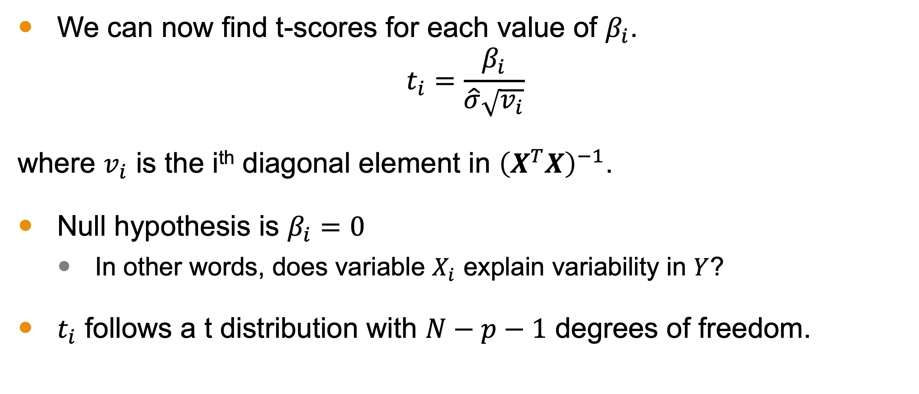
t-score for $\hat{β}$
We can now find t-scores for each value of $β_{i}$.
$$t_{i}=\frac{β_{i}}{\hat{σ}\sqrt{v_{i}}}$$
where $v_{i}$ is the i^{th} diagonal element in ${\left(X^{T}X\right)}^{−1}$.
Null hypothesis is $β_{i}=0$
In other words, does variable $X_{i}$ explain variability in $Y$?
$t_{i}$ follows a t distribution with $N−p−1$ degrees of freedom.
Notes:
An example is provided in the supplemental materials

Slide 13
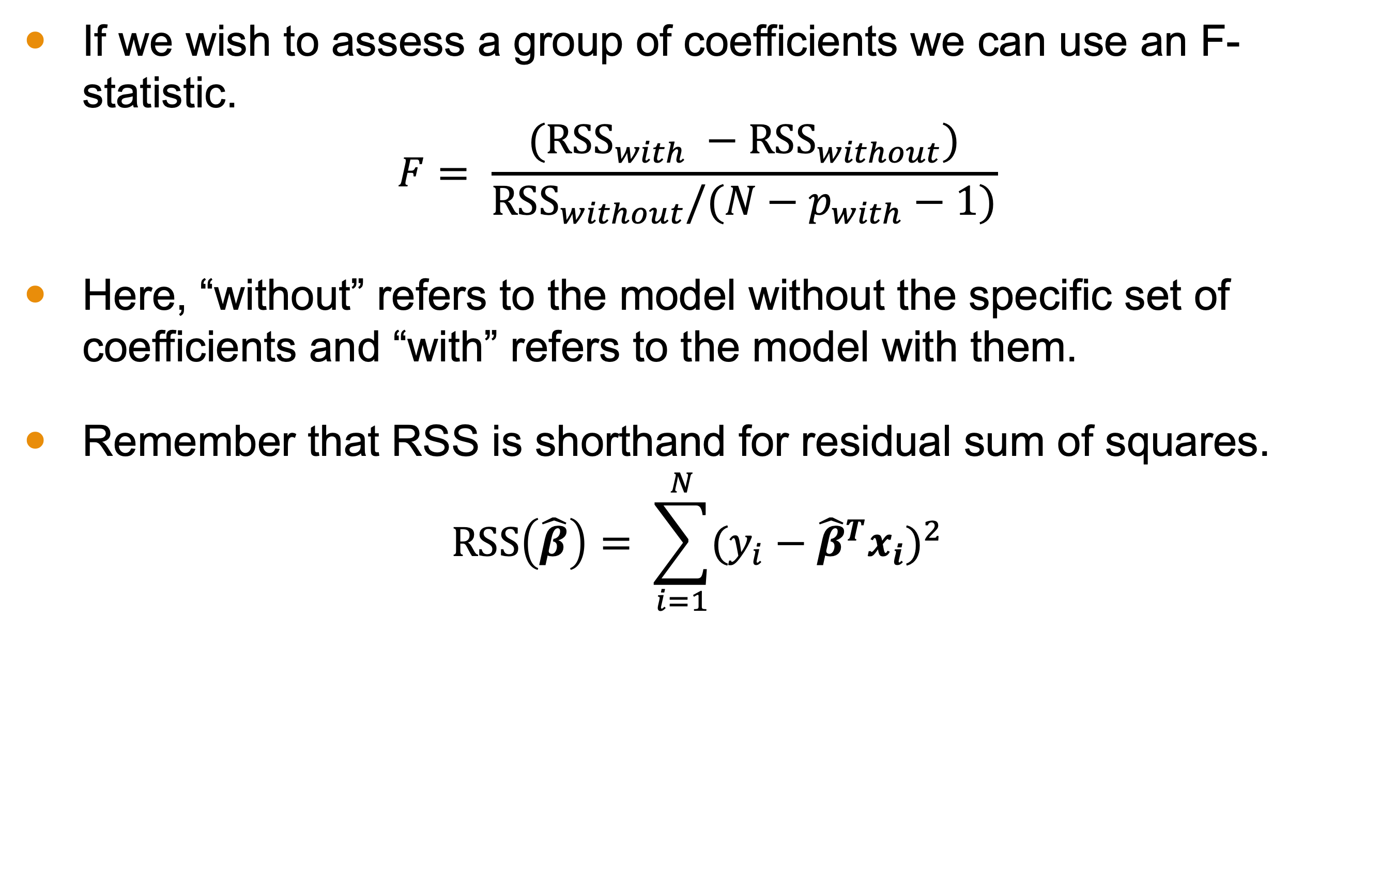
F-statistics
If we wish to assess a group of coefficients we can use an F-statistic.
$$F= \frac{({RSS}_{with} −{RSS}_{without})}{{RSS}_{without}/(N−p_{with}−1)}$$
Here, “without” refers to the model without the specific set of coefficients and “with” refers to the model with them.
Remember that RSS is shorthand for residual sum of squares.
$$RSS\left(\hat{β}\right)= \sum_{i=1}^{N}{{(y_{i}−{\hat{β}}^{T}x_{i})}^{2}}$$

Slide 14
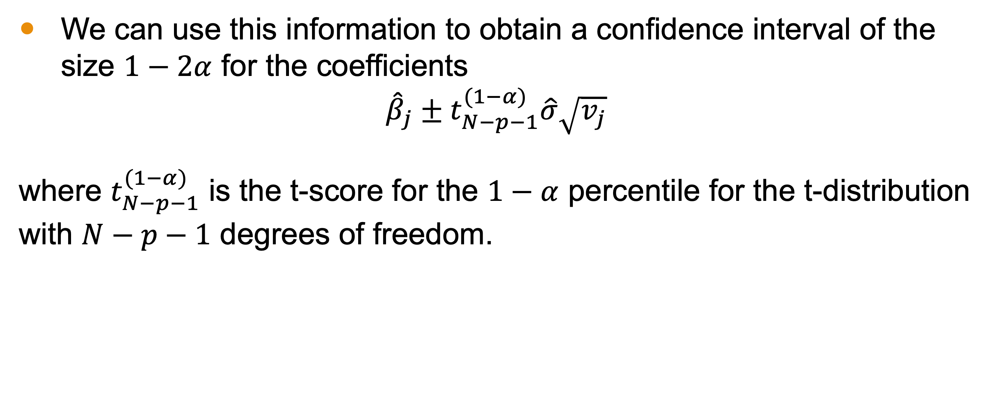
Confidence Intervals for Coefficients
We can use this information to obtain a confidence interval of the size $1−2α$ for the coefficients
$${\hat{β}}_{j}±t_{N−p−1}^{(1−α)}\hat{σ}\sqrt{v_{j}}$$
where $t_{N−p−1}^{(1−α)}$ is the t-score for the $1−α$ percentile for the t-distribution with $N−p−1$ degrees of freedom.

Slide 15
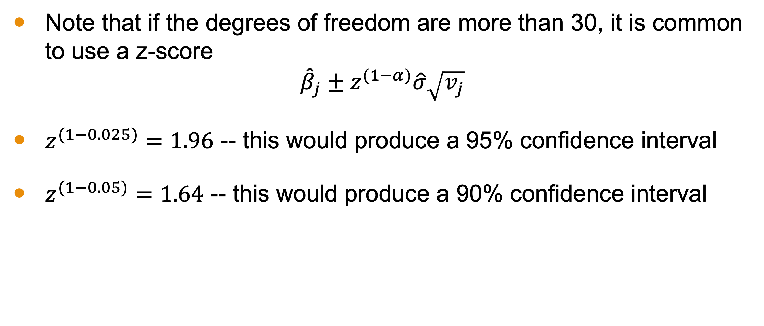
Confidence Intervals for Coefficients
Note that if the degrees of freedom are more than 30, it is common to use a z-score
$${\hat{β}}_{j}±z^{(1−α)}\hat{σ}\sqrt{v_{j}}$$
$z^{(1−0.025)}=1.96$ -- this would produce a 95% confidence interval
$z^{(1−0.05)}=1.64$ -- this would produce a 90% confidence interval
Notes:
Some could be more conservative and focus on 100

Slide 16
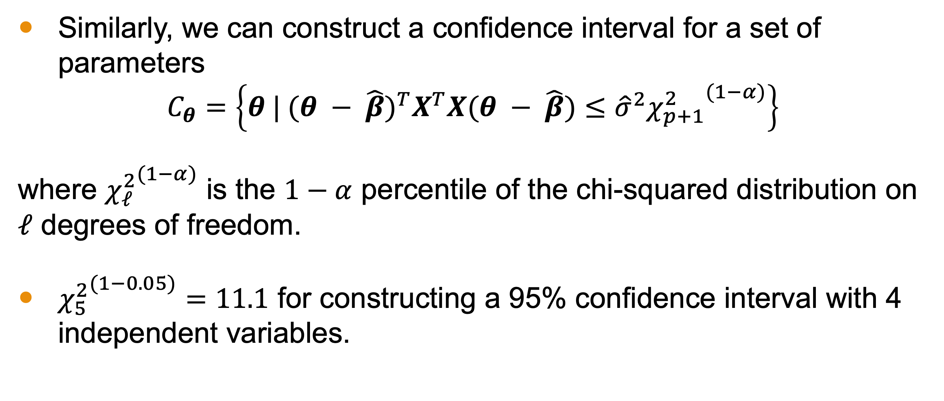
Confidence Intervals
Similarly, we can construct a confidence interval for a set of parameters
$$C_{θ}=\left\{θ | {(θ − \hat{β})}^{T}X^{T}X(θ − \hat{β})≤{\hat{σ}}^{2}{χ_{p+1}^{2}}^{(1−α)}\right\}$$
where ${χ_{ℓ}^{2}}^{(1−α)}$ is the $1−α$ percentile of the chi-squared distribution on $ℓ$ degrees of freedom.
${χ_{5}^{2}}^{(1−0.05)}=11.1$ for constructing a 95% confidence interval with 4 independent variables.

Slide 17
Let’s do an example of a t-test on a specific coefficient.

Slide 18
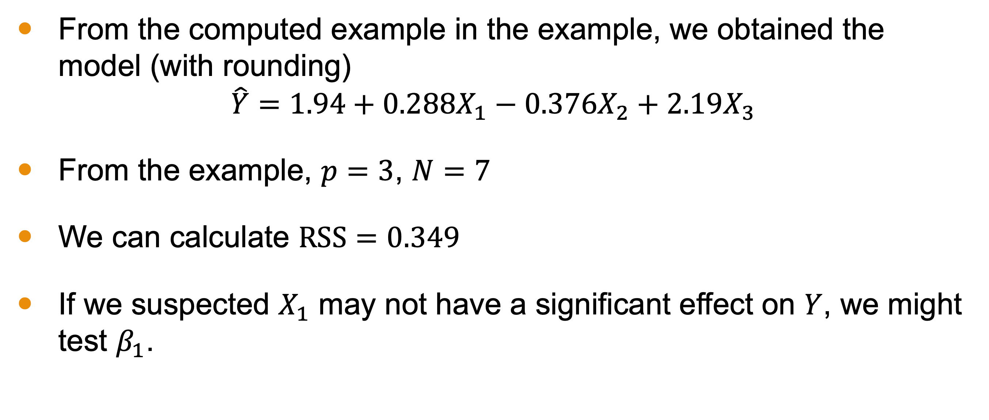
Example of a Statistical Test
From the computed example in the example, we obtained the model (with rounding)
$$\hat{Y}=1.94+0.288X_{1}−0.376X_{2}+2.19X_{3}$$
From the example, $p=3$, $N=7$
We can calculate $RSS=0.349$
If we suspected $X_{1}$ may not have a significant effect on $Y$, we might test $β_{1}$.

Slide 19
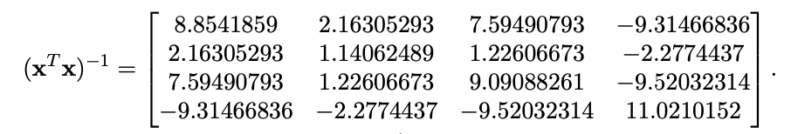


Example of a Statistical Test Continued
$$\hat{Y}=1.94+0.288X_{1}−0.376X_{2}+2.19X_{3}$$
$$p=3, N=7, RSS=0.349, {\hat{σ}}^{2}=\frac{1}{3}\left(0.349\right)=0.116$$
$$z_{1}=\frac{β_{1}}{\hat{σ}\sqrt{v_{1}}}=\frac{0.288}{0.341\sqrt{1.14}}=0.791$$

Slide 20
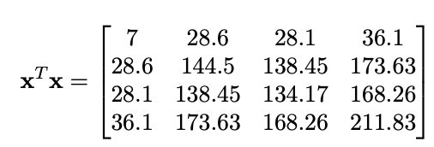

Example of a Statistical Test Continued
$$\hat{Y}=1.94+0.288X_{1}−0.376X_{2}+2.19X_{3}$$
$$p=3, N=7, RSS=0.349, {\hat{σ}}^{2}=\frac{1}{3}\left(0.349\right)=0.116$$
P-value = 0.487!
$$z_{1}=\frac{β_{1}}{\hat{σ}\sqrt{v_{1}}}=\frac{0.288}{0.116\sqrt{144.5}}=0.207$$

Slide 21

Here, we fail to reject the null! We would conclude $β_{1}=0$.

Slide 22
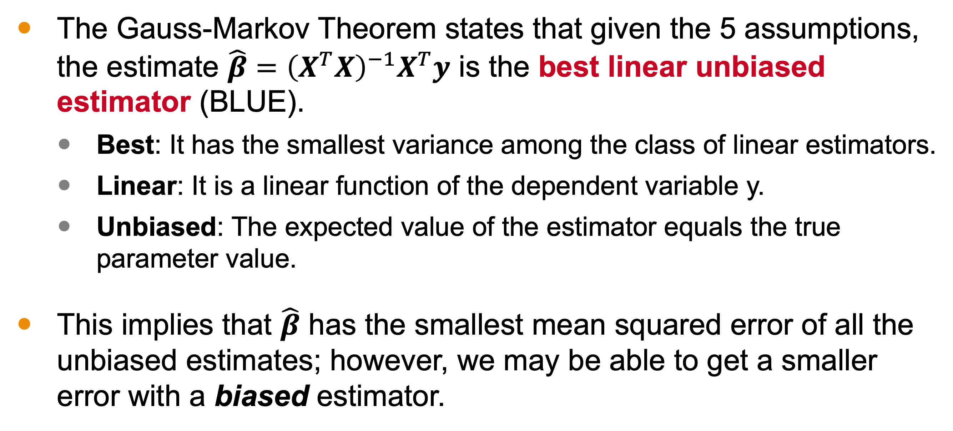
The Gauss-Markov Theorem
The Gauss-Markov Theorem states that given the 5 assumptions, the estimate $\hat{β}={\left(X^{T}X\right)}^{−1}X^{T}y$ is the best linear unbiased estimator (BLUE).
Best: It has the smallest variance among the class of linear estimators.
Linear: It is a linear function of the dependent variable y.
Unbiased: The expected value of the estimator equals the true parameter value.
This implies that $\hat{β}$ has the smallest mean squared error of all the unbiased estimates; however, we may be able to get a smaller error with a biased estimator.

Slide 23
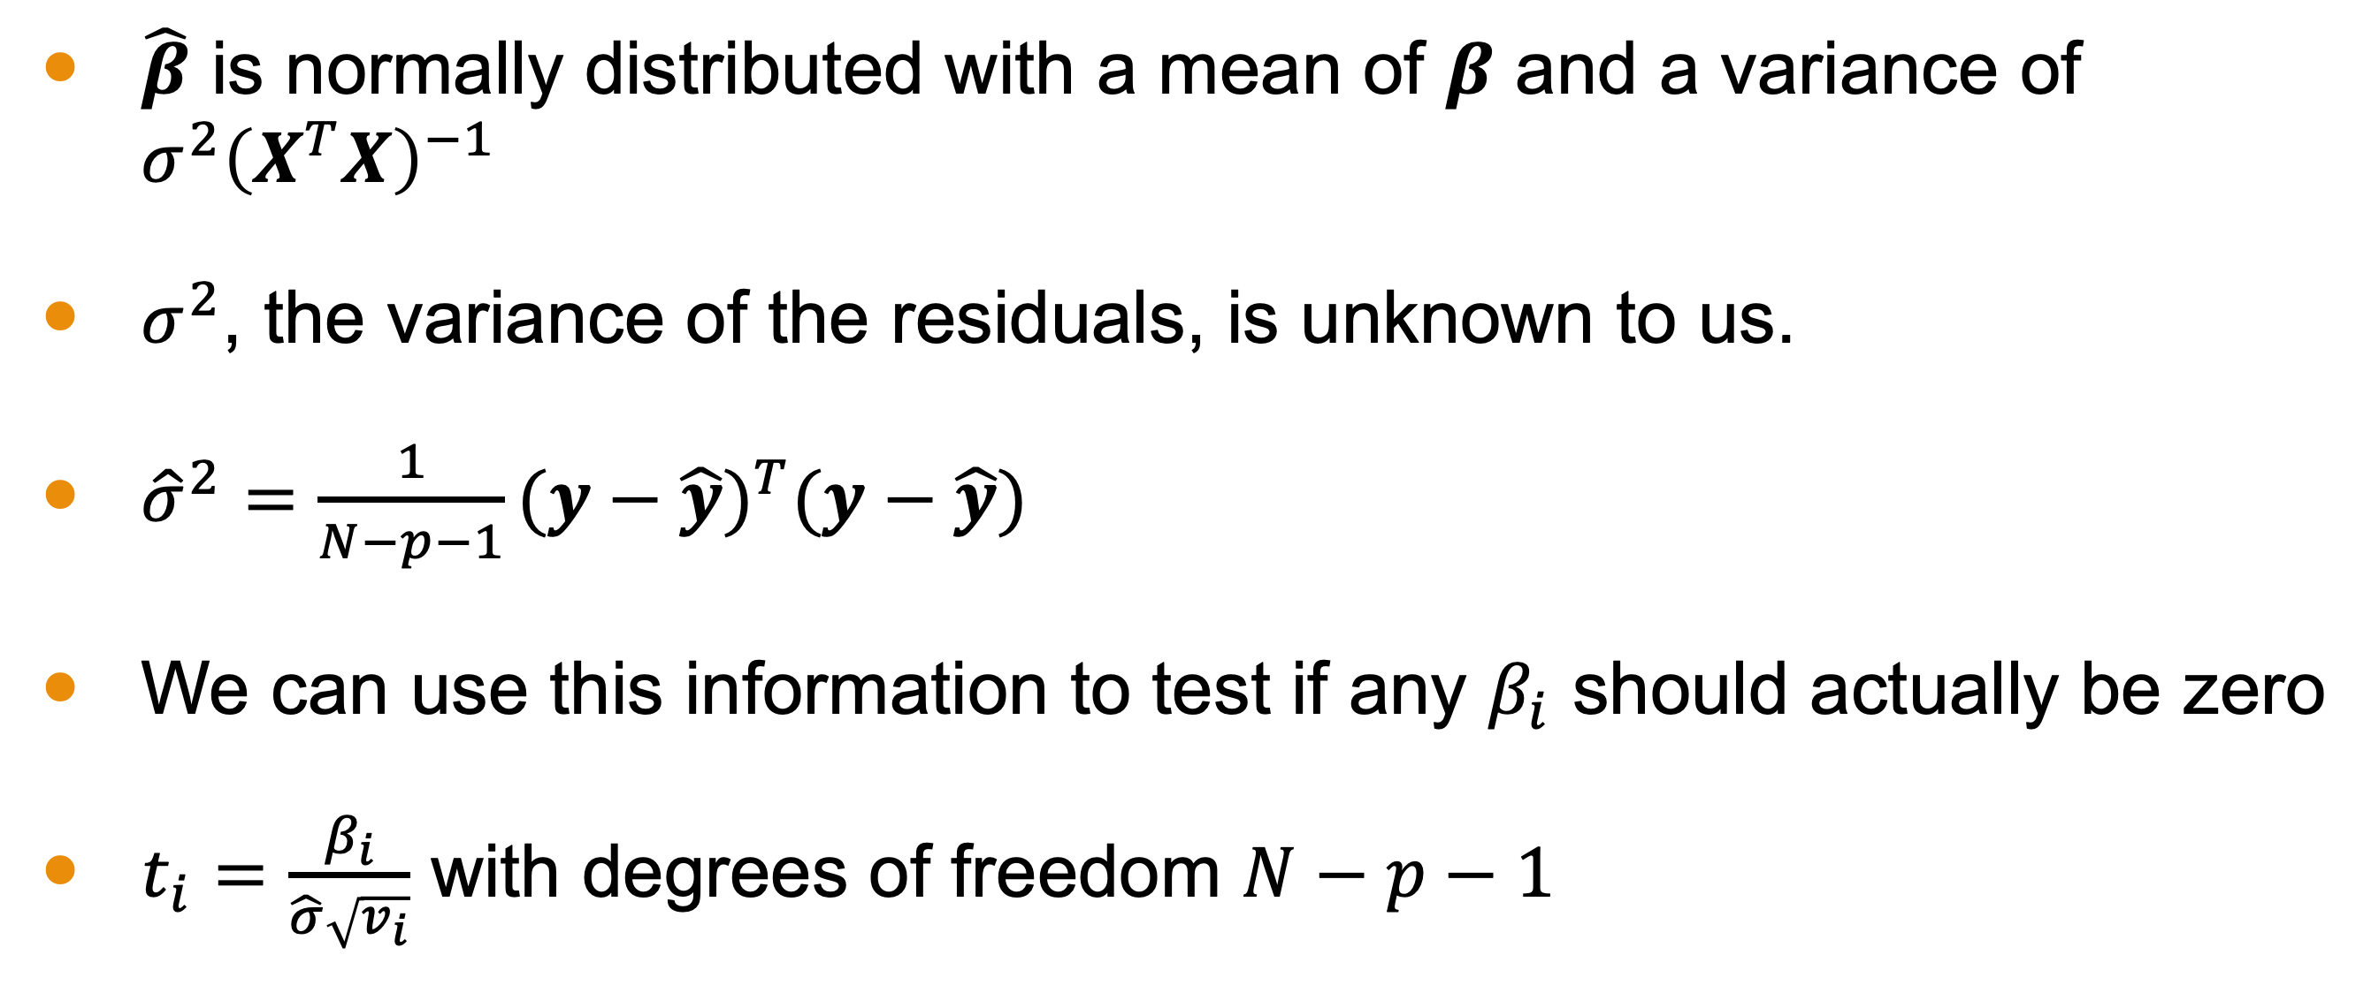
Conclusion
$\hat{β}$ is normally distributed with a mean of $β$ and a variance of ${σ^{2}\left(X^{T}X\right)}^{−1}$
$σ^{2}$, the variance of the residuals, is unknown to us.
${\hat{σ}}^{2}=\frac{1}{N−p−1}{(y−\hat{y})}^{T}(y−\hat{y})$
We can use this information to test if any $β_{i}$ should actually be zero
$t_{i}=\frac{β_{i}}{\hat{σ}\sqrt{v_{i}}}$ with degrees of freedom $N−p−1$

Slide 24
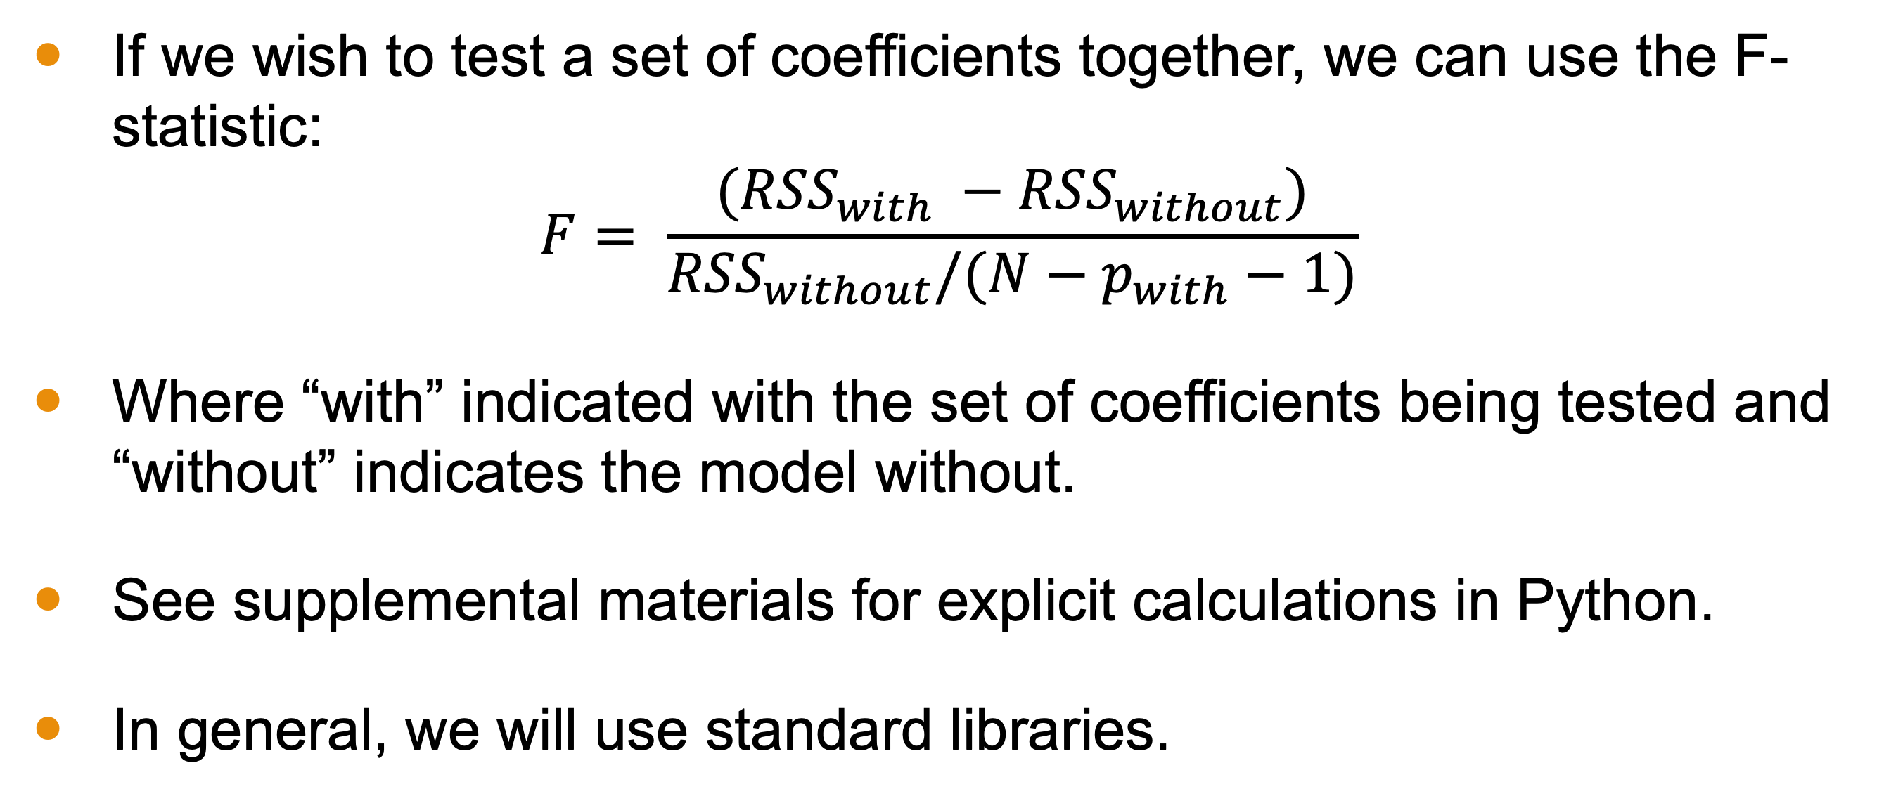
Conclusion
If we wish to test a set of coefficients together, we can use the F-statistic:
$$F= \frac{({RSS}_{with} −{RSS}_{without})}{{RSS}_{without}/(N−p_{with}−1)}$$
Where “with” indicated with the set of coefficients being tested and “without” indicates the model without.
See supplemental materials for explicit calculations in Python.
In general, we will use standard libraries.

Slide 25

Conclusion
The Gauss-Markov Theorem states that the $\hat{β}$ equation we derived is the Best Linear Unbiased Estimator (BLUE).
A biased estimator could produce a smaller mean squared error.

